Slide 1
Transfer Pricing & Expatriate
They Could Cross!
August 20, 2015
UTA
Mary K. Thomas
Weaver, LLP
972-448-6965
Slide 1

Slide 2
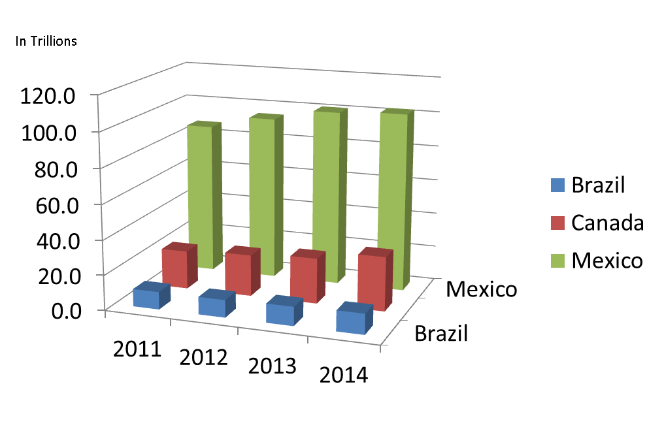
Texas Exports
 | Brazil | Canada | Mexico
2011 | 10.1 | 22.1 | 87.2
2012 | 10.0 | 23.9 | 94.4
2013 | 10.9 | 26.1 | 100.9
2014 | 11.8 | 31.1 | 102.6
Amounts noted in Trillions of USD
Slide 2
Notes:
What country do you think is Texas’s forth largest recipient of Texas Exports? China

Slide 3
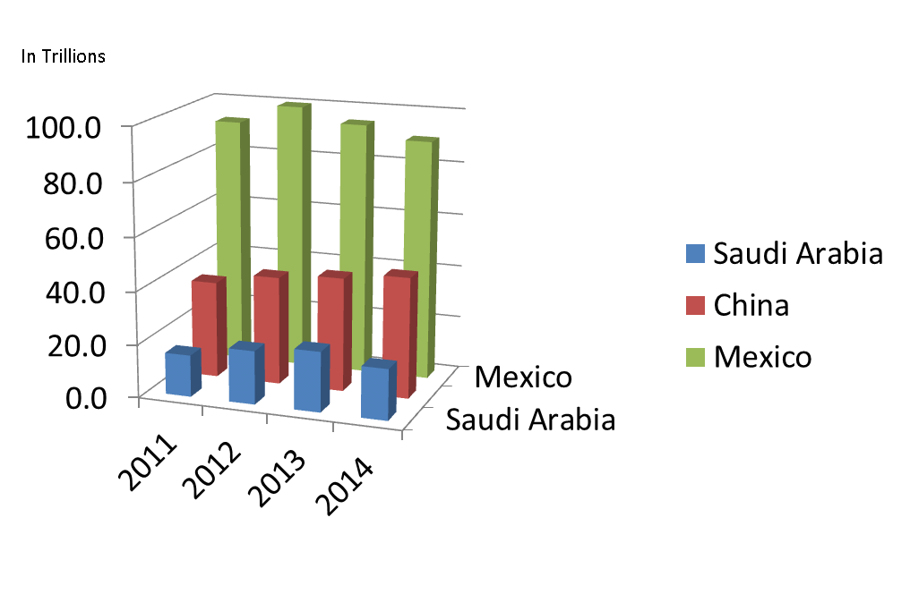
Texas Imports
 | Saudi | China | Mexico
2011 | 15.7 | 36.4 | 92.6
2012 | 20.1 | 40.7 | 99.9
2013 | 22.6 | 42.8 | 94.7
2014 | 19.1 | 45.4 | 90.1
Amounts noted in Trillions of USD
Slide 3
Notes:
What country do you think is Texas’s forth largest importer? Canada
Crude Oil imports to Texas went from 113.7 in 2011 down to 107 in 2012, 88.2 in 2013, and 76.1 in 2014.

Slide 4
Transfer Pricing
  US Inbound and Outbound Transactions
  US Income Tax Significance
Slide 4

Slide 5
Definition – TP/TPing
  The definition of a transfer price is the price at which controlled or related entities set for goods, services, or use of property/intangibles.
  Transfer Pricing refers to the documentation or the setting of charges between related parties that are arm’s length – i.e., what unrelated parties would charge under similar circumstances.
  The underlying premise to Transfer Pricing is that profits or costs incurred in a transaction are tied to the functions performed and to the risks assumed.
Slide 5
Notes:
Go over “pencil” example if I were selling to Walmart as an example of “controlled” versus related parties

Slide 6
Valuing Profit Drivers
Easy part: establishing profit margins for routine activities:
  Toll or contract manufacturing
  Limited risk distribution
  Contract services
Hard part: carving up residual profit
  Risk
  IP
  Customer base
Slide 6

Slide 7
Why Bother?
IRC 6662(e) penalty avoidance
  Documentation contemporaneous to filing of US return (OECD countries require documentation before transaction takes place)
  Transactional penalty – price for property or service is 200% more or 50% less than “correct price”
  Net Adjustment Penalty – transfer pricing adjustment exceeds lesser of (a) 5 million or (b) 10% of gross receipts
Slide 7
Notes:
Penalty under 6662(e) is 20% of the tax underpayment attributable to the Tping adjustment.

Slide 8
Why Bother?
Determining Intercompany Prices
  Start-up or supply chain changes made by an organization
  Financial statement audit
  Value of goods imported into the US for duty purposes
Reduce Risk of Double Taxation
  Global study to address all countries affected
  Growing concern of BEPS in OECD countries with efforts to increase tax transparency
Slide 8
Notes:
BEPS – “Base Erosion and Profit Shifting

Slide 9
Expatriates
An expatriate refers to an individual who lives outside their native country.
  Includes individuals who forfeit citizenship and exiles themselves from one’s native country
  International assignments
    Outbound – employer sending U.S. employee to a foreign location to work.
    Inbound – employer sending non-U.S. employee to a U.S. location to work.
Slide 9

Slide 10
Expatriates
  Issues to address regarding international assignments
    Deciding employment relationship – will home-country continue as employer?
    May employee be subject to social security tax in both the home and host countries or is an exemption available under a Totalization Agreement?
    Tax equalization payment will be made to employee to equalize for any additional taxes owed?
    Estate taxation planning and tax filings to be paid by employer?
Slide 10

Slide 11
Expat Association
How is transfer pricing related to Expats?
  If home-country company (employer) continues paying expat salary but expat performs services for a related party in another country, transfer pricing applies when:
    Employer cross-charges the other company for services performed
    Employer is treated as having a permanent establishment (PE) in the other country.
Slide 11

Slide 12
Permanent Establishment
Profits are attributable to a PE in an amount in which the PE would have made if it were a distinct and separate enterprise engaged in similar or same activities.
Includes only profits derived from the assets used, risks assumed, and activities performed by the PE.
This is a transfer pricing exercise of allocating income and expenses according to the risks assumed, assets utilized, and functions performed as if PE were a separate business.
Slide 12

Slide 13
US vs Non-US Resident
  Determination of whether an individual qualifies as a US resident (taxed on worldwide income) or a non-US resident (taxed on US-sourced income) can be determined in a number of ways.
 | US Resident | Non US Resident
Green card holder | X
Citizen of the US | X
Substantial Presence Test Met | X
Substantial Presence Test Met but Treaty Exemption Claimed |  | X
First Year Election Made | X
Closer Connection |  | X
Slide 13
Notes:
Closer Connection to a Foreign Country
Even if you meet the substantial presence test, you can be treated as a nonresident alien if you:
Are present in the United States for less than 183 days during the year,
Maintain a tax home in a foreign country during the year, and
Have a closer connection during the year to one foreign country in which you have a tax home than to the United States

Slide 14
Non-US Resident
US Taxable Income
U.S. source investment income
  Taxed on gross income with no deductions permitted
  Taxed at a 30% rate via withholding unless reduced by tax treaty
US source Fixed Determinable Annual and Periodic (FDAP) income
  Interest, dividends, rents, royalties
  30% statutory rate on gross income
    US Payor is withholding agent
  Certain statutory and treaty exemptions exist
Capital gains generally tax free to foreign investors
  Exception for gains from the disposition of US real property (FIRPTA)
U.S. Estate Taxation
  Value of U.S. gross estate > $60k, an estate tax return (form 706-NA) is required.
  U.S. has approximately 16 death tax treaties in effect.
Slide 14

Slide 15
Your Questions???
Mary Thomas, CPA JD
International Tax Services Partner
Weaver
www.weaver.com
Tel.: +972.448.6965
Mobile: office phone routes to cell
E-Mail: mary.thomas@weaver.com
Slide 15

